Slide 1
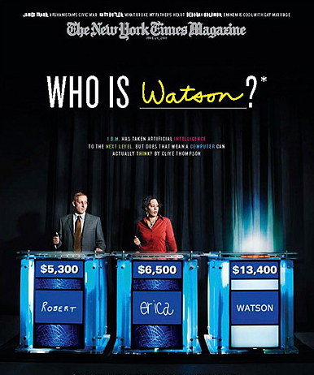
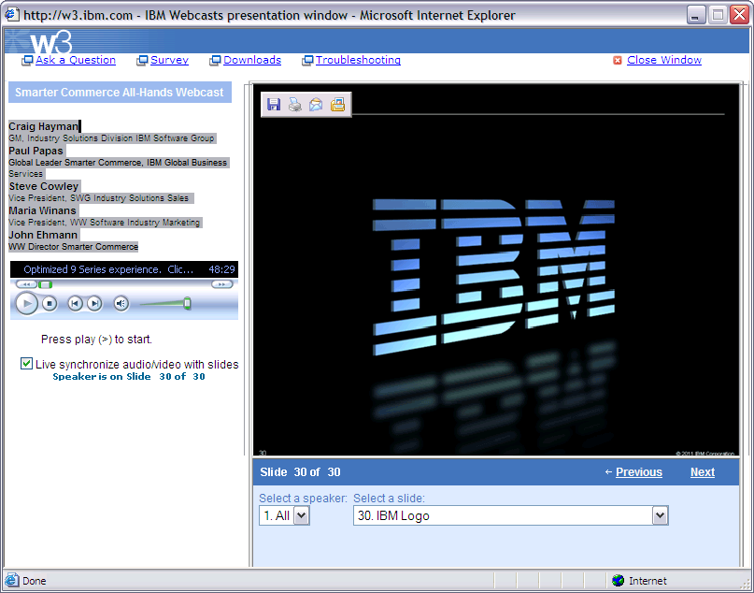
Predictive Perspectives
Analytics for a Smarter Campus
June 23
Stephen Gold

Slide 2

The Analytics Market Remains Hot $76B market by 2015
Information & Analytics Market
$60B in 2011; 6.4% CGR ′10-′15
Analytic Applications
$7.3B ′11;
7.0% CGR ′10-′15
SPSS
WebSphere
Info Integration & MDM
$4.9B ′10;
8.3% CGR ′10-’15
DW DBMS
$6.9B ′11;
7.1% CGR ′10-′15
BI Platform & PM
$15.0B ′11;
7.7% CGR ′10-′15
Cognos
DB2, Informix, InfoSphere
IBM
Data Mgmt & IDM
$18.9B ′11;
4.2% CGR ′10-′15
Content Management
$6.9B ′11;
6.7% CGR ′10-′15
ECM
Source: GMV 2H10 (incl. analytic applications)
Notes:
2

Slide 3

Analytics Means Better Performance
Organizations that lead in analytics outperform those who are just beginning to adopt analytics
3x
Top decision makers are more likely to use an analytic approach over intuition*
5.4x
Source: Analytics: The New Path to Value, a joint MIT Sloan Management Review and IBM Institute of Business Value study.
*within business processes
Notes:
Analytics correlates to performance

Slide 4
Analytics-Driven Organizations Outperform
49% more
30% more
> 20x more
EBITDA
5-year CAGR, 2004-2008
Revenue
5-year CAGR, 2004-2008
ROIC
5-year average, 2004-2008
Value Integrators
All other enterprises
Revenue Growth: N = 580; EBITDA: N = 531; ROIC: N = 501;
Source: IBM Institute for Business Value, The Global CFO Study 2010
₄

Slide 5




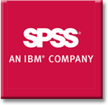


Analytics at Work
Predictive
Descriptive
Prescriptive
Stochastic Optimization
How can we achieve the best outcome including the effects of variability?
Prescriptive
Optimization
How can we achieve the best outcome?
Predictive modeling
What will happen next if ?
Simulation
What could happen … ?
Predictive
Degree of Complexity
What if these trends continue?
Forecasting
Alerts
What actions are needed?
Query/drill Down
What exactly is the problem?
How many, how often, where?
Descriptive
Ad hoc Reporting
Standard Reporting
What happened?

Slide 6
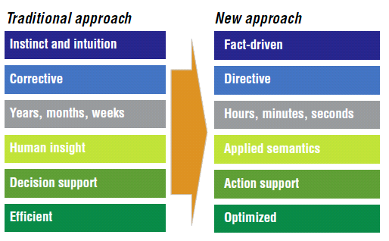
On a Smarter Planet, new institutional challenges and conditions have placed a renewed urgency on business analytics and optimization
Obstacles to adoption of analytics
New ways of working in the smarter collegial environment
Automated

Slide 7



Information is the “Analytic” Elixir
In 2001, there were 60 million transistors for every human on the planet ... in 2010 there were 1 billion transistors per human
Volume of Digital Data
57% CAGR for enterprise data through 2010
In 2005 there were 1.3 billion RFID tags in circulation…last year there were 33 billion RFID tags and growing more than 100% each year.
Variety of Information
80% of new data is unstructured
Worldwide mobile telephone subscriptions reached 5 billion in 2010.
Velocity of Decision Making
An estimated 2 billion people will be on the Web by 2011 ... with over a trillion connected objects

Slide 8
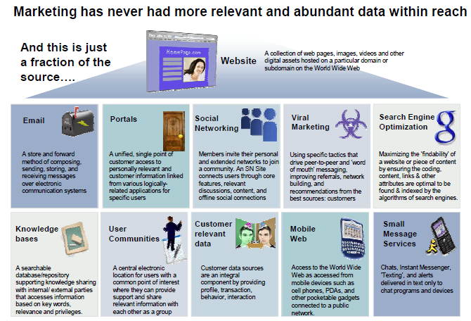
Educators have more access to relevant and abundant data than ever before…
Source: ITSMA’s Annual Marketing Conference (October 27-28, 2009) http://www.itsma.com/pdfs/09conference/White_IBM.pdf
8

Slide 9
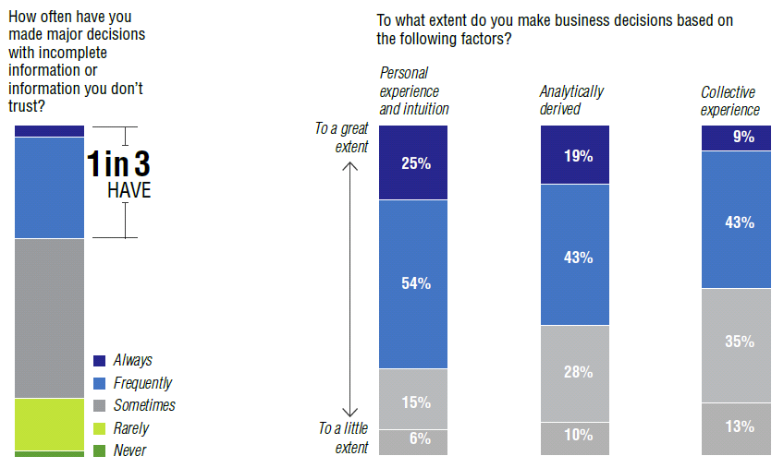
…and yet lack the information, or access to the data, to make fact based decisions.
9
Source: Business analytics and optimization for the intelligent enterprise, IBM Institute for Business Value

Slide 10



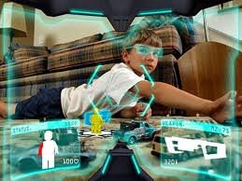
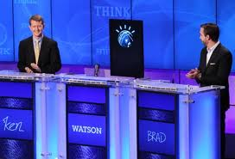
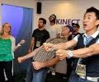

6 Trends Affecting Higher Ed -
2011 Horizon Report
(New Medium Consortium & Educause)
Mobile Devices
Electronic Books
Augmented Reality
Game Based Learning
Gesture Based Learning
Learning Analytics

Slide 11

IBM IS BETTING BIG ON ANALYTICS ...
IBM sees strong growth in its business analytics initiatives. Most recently in 2010, IBM's business analytics revenue grew at 19% during fourth-quarter.
In the last 48 months, IBM has invested more than $14 billion in 24+ acquisitions to expand its analytics capabilities.
As part of IBM's Business Analytics and Optimization service line, there are more than 8,000 dedicatd analytical business consultants
More than 200 IBM mathematicians focus exclusively on analytics.
To date, IBM has received nearly 500 analytics patents.
The Company's 2015 roadmap projects $16 billion in business analytics and optimization revenue by 2015.

Slide 12

Drove creation of Predictive Analytics Market
July 28, 2009
40+ year heritage
(Now a critical part of IBM’s Business Analytics Family)
IBM acquires SPSS Inc, a leader in predictive analytics and statistics, for $1.2B
1,300 employees
With one mission in mind --
Drive optimal outcomes through predictive analytics !
Notes:
As you know, SPSS joined the IBM family last year.
As has been our commitment before the acquisition, our dedication to our customers and their support remains as strong as ever, and continues to grow.
IBM intends to support your investments in SPSS by leveraging IBM's world-class technology resources to deliver innovative solutions and expanded value. Building on a tradition of client success and satisfaction, IBM plans to leverage its extensive global resources to enhance and expand your service and support offerings, both directly and through business partners.
SPSS had established itself as leader in Predictive Analytics – in fact, it was SPSS that drove the vision of predictive analytics and the emergence of this market. Over our 40 year history, though, our overall aim has been the same: to drive the widespread use of data in decision making. And our mission today is to enable organisations to use predictive analytics to transform their business, by driving optimal outcomes.
In short, and we look forward to continuing to provide innovative products and services for you and your organization for many years to come.

Slide 13

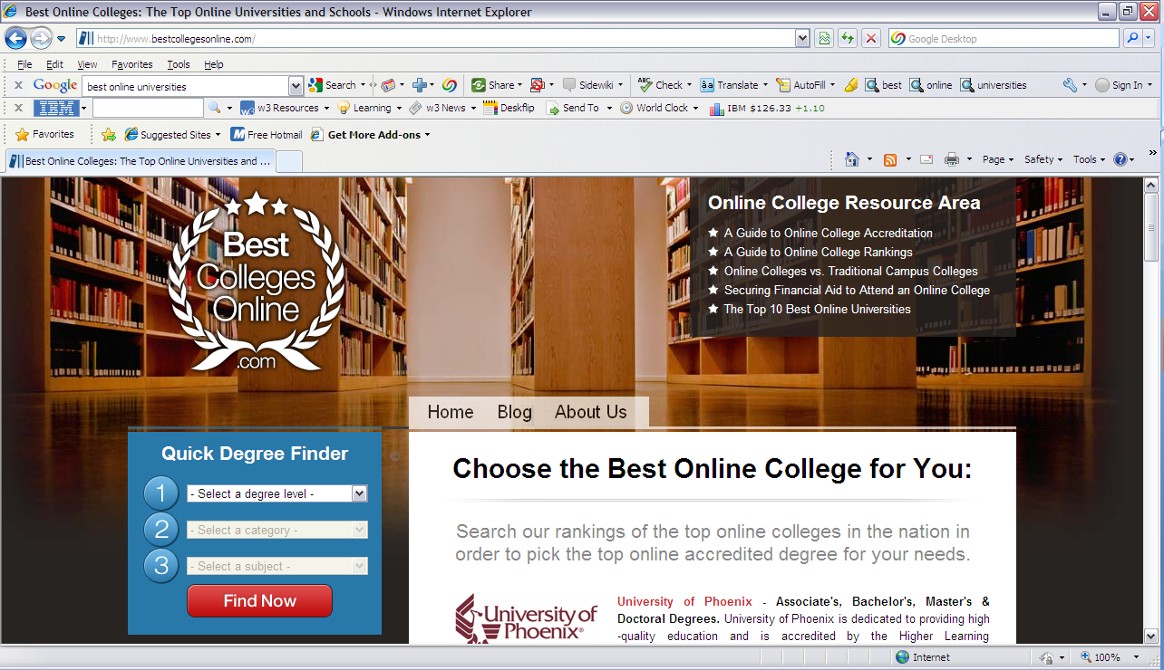

















IBM SPSS Academic Facts
Over the past 3 years IBM SPSS academic customers represented:
80% of all colleges and universities
100% of Ivy League Schools
All 25 of Forbes 2009 America’s Top Best Colleges
97% of Forbes 2009 America’s 100 Best Public Colleges
95% of Forbes 2009 America’s 100 Best Private Colleges
9 out of the Top 10 Online Colleges
Vanderbilt
*Source: Carnegie Foundation for the Advancement of Teaching, Carnegie Classifications Data File, June 19, 2009.
**Source: American Association of Community Colleges
Notes:
The acquisition of SPSS also underscores IBM’s deep seeded commitment to educational community and builds on a long and productive legacy SPSS has enjoyed with top tier institutions across the globe.

Slide 14


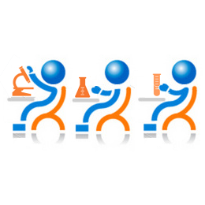


IBM SPSS – Supporting Academia
Classroom
At Home
Computer Lab
Research Lab
Textbooks &
Homework

Slide 15
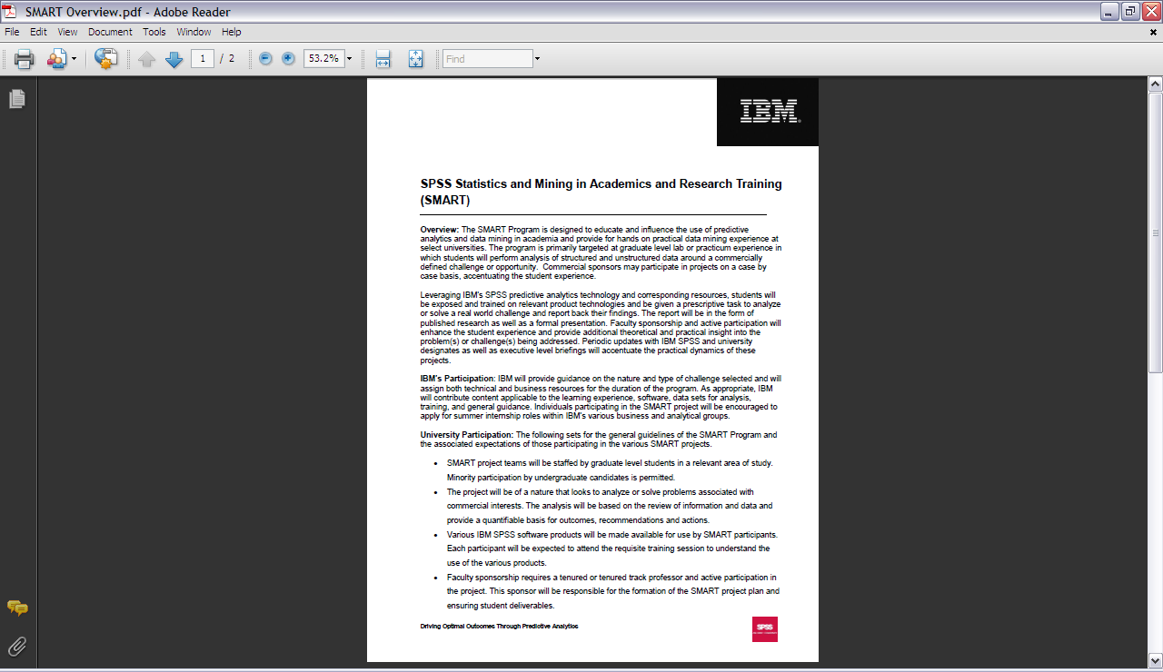
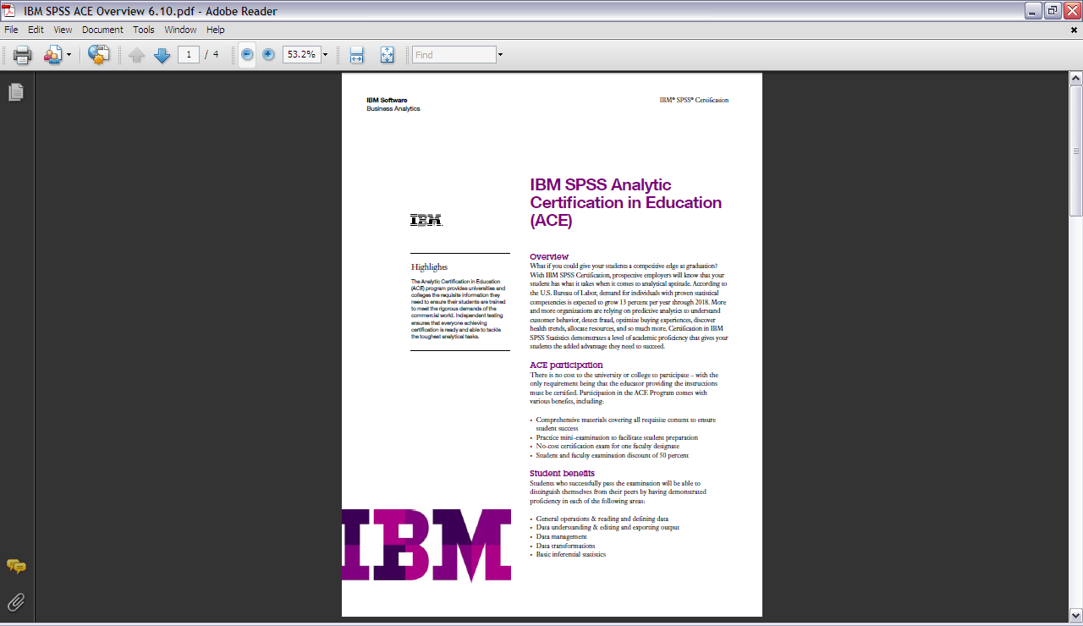
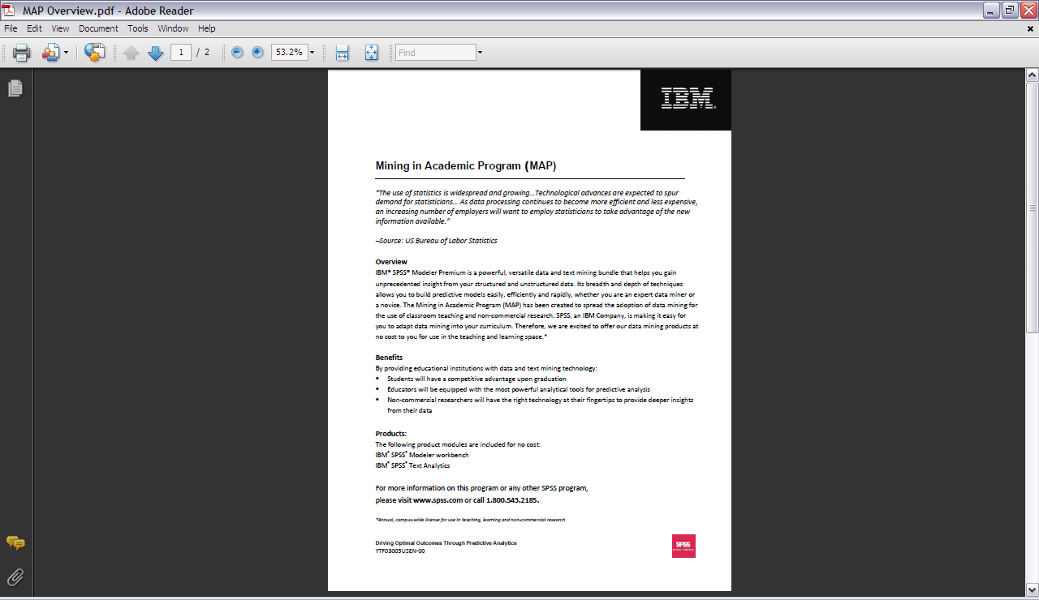

IBM SPSS Academic Programs
New Deal – Campus wide unlimited license featuring special bundles and license riders
Analytic Certification in Education (ACE)
Statistics and Mining in Academic Research and Training (SMART) – a collaboration between IBM and universities
Mining in Academic (MAP) –provides latest technology for research & teaching
Turnkey Teaching –resource library
Virtual Computer Lab – technology in the cloud
MAP
ACE
SMART
15

Slide 16


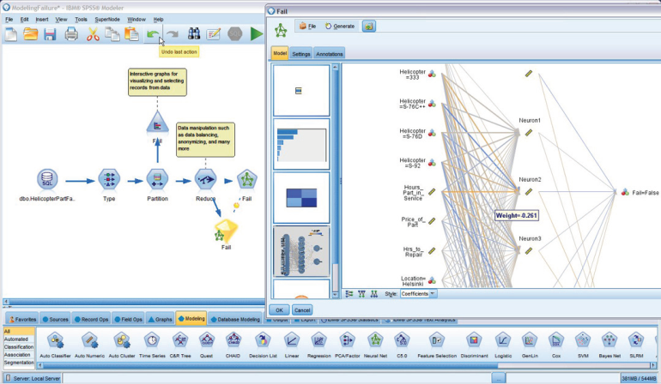
IBM SPSS - Mining in Academia Program (MAP)
Overview
The Mining in Academia Program (MAP) has been created to support the adoption of data and text mining in classroom teaching and non-commercial research. IBM will offer its data and text mining product – IBM SPSS Modeler Premium - at no cost.
IBM SPSS Modeler Premium
Data Mining workbench that is power and versatile, helping users gain unprecedented insight from structured and unstructured data
Text Analytics functionality to help users combine structured and unstructured data for the most accurate predictive models possible
Natural Language Processing (NLP) technology, for extracting key concepts, sentiments and relationships from textual or “unstructured” data and converting them to a structured format that can be used to make predictive models more accurate
Auto Modeler capabilities to efficiently perform an in-depth analysis of your data to determine what algorithm, classification technique, or artificial intelligence methodology best fits the predictive outcome

Slide 17
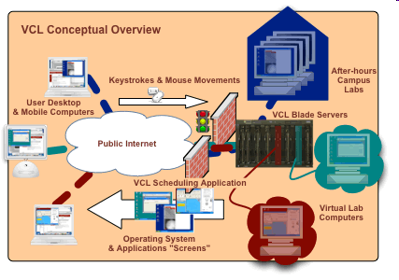
IBM SPSS – Virtual Computer Licenses (VCL)
VCL delivers…
Savings in software licensing cost
Increase in students served per application license
Higher student satisfaction through more convenient access
Increased flexibility to shift computing capacity between instruction and research
Ability to meet significant growth in enrollment without building additional computing labs
Increased security and protection for user data and access
Overall improvement in server utilization
Notes:
In summary, VCL provides numerous benefits from saving energy and individual license costs to supporting distance learning. The VCL deployment would allow universities to allocate their IT infrastructure more efficiently than ever before. Most importantly, VCL meets the needs of faculty and students, ensuring an increased customer satisfaction rate.

Slide 18





Real-World Experience…Getting SMART! IBM - University Collaboration
Yale University
Insurance Fraud
DePaul University
Center for Data Mining & Predictive Analytics
M.S. in Predictive Analytics
University of Connecticut
Performance vs. Service Level Agreements
Fordham University
Health Prize Competition
Northwestern University
Masters of Predictive Analytics (Continuing Education)
Social Media & Corporate Reputation Management
18

Slide 19

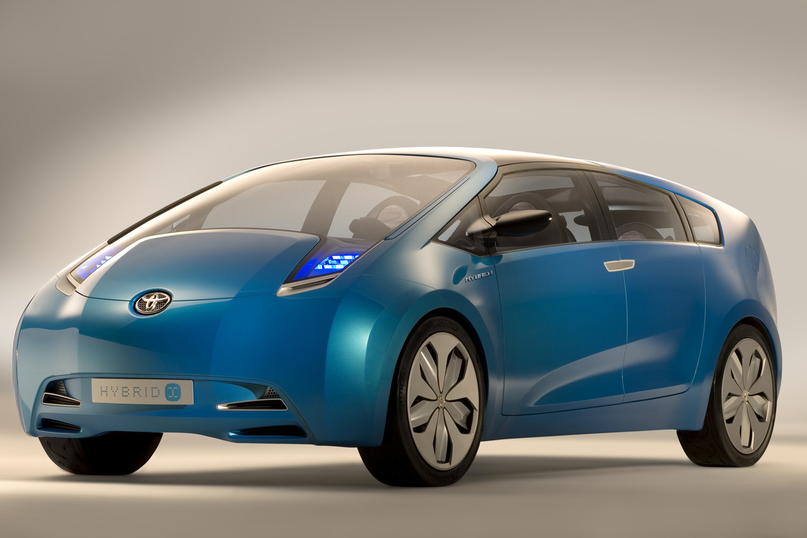
Learning from Failure: Toyota Misses the Mark on Building Brand Value
A Kellogg School of Management Graduate Project

Slide 20
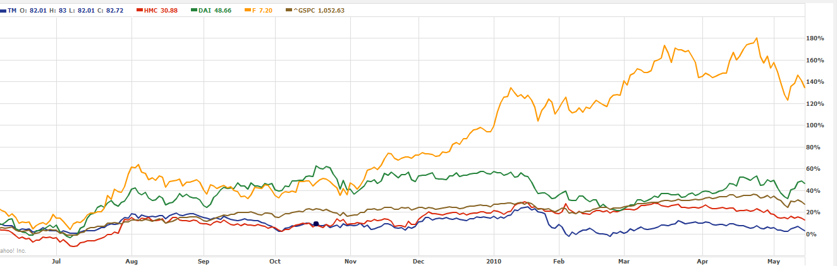

Toyota Relative Stock Performance
Competition gains share while Toyota loses!
$25B lost market cap; $2B litigation;
$1.1B warranty claims, $0.9B lost sales

Slide 21

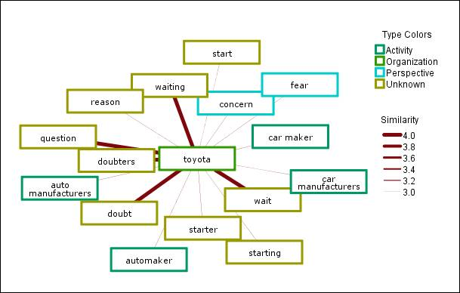
Toyota: Brand Impact
Toyota enthusiasts report “waiting” to see how the crisis develops.
“Doubt” and “question” show that some skepticism of the recall exists.
Note: “safety” , “quality” and “value” don’t appear on the map. Consumers wait as crisis unfolds, but they don’t fundamentally doubt Toyota’s products.

Slide 22

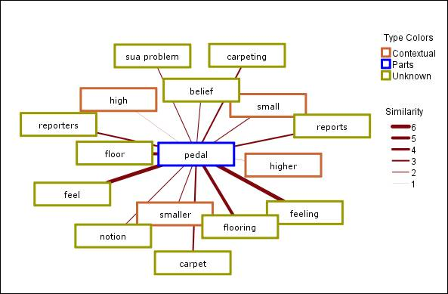
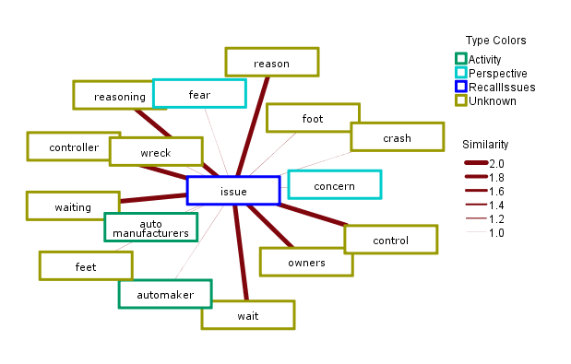
Toyota: Understanding Sentiment
“Carpeting” and “flooring” shows that conversation on the pedal malfunction is still heavily influenced by the floor mat recall.
Going forward, people report waiting for the crisis to resolve. Fear and concern still exist, and owners are still talking about foot pedals and controllers.

Slide 23
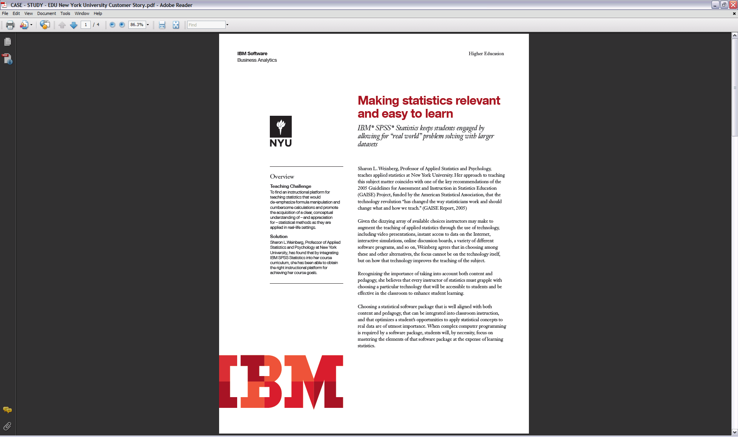



Analytics in Education
“…de-emphasize formula manipulation and
cumbersome calculations and promote clear, conceptual understanding of – and appreciation
for – statistical methods .”
“…provide the Applied Psychology
students with practical quantitative skills
that enable them to better compete in the job market.”
“…make students more “job ready” by teaching the entire research process, instead of just the end product.”
“…flexible, user-friendly
statistical and data mining tools that could
manage multiple data formats .”

Slide 24
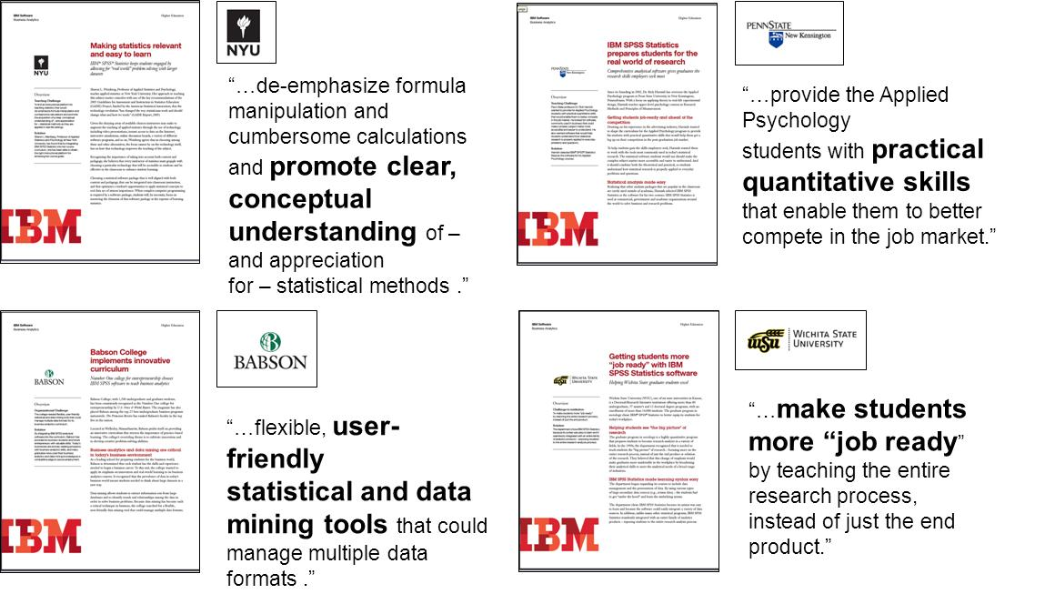

Analytics in Education
24

Slide 25
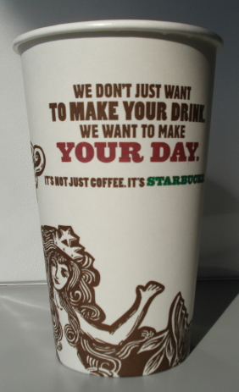
25
Voice of the Student
I’ll have…A “venti, no-fat, sugar-free, extra hot Cinnamon-peppermint (2 pumps), light blend Dolce Latte, no whip - but please leave room for cream…”
Notes:
At my local Starbucks this morning the client in front of me asks for a “venti, no-fat, sugar-free, extra hot Cinnamon-peppermint (2 pumps), light blend Dolce Latte, no whip - but please leave room for cream…”
Aside from “would you like some coffee with that…?”, I though “how many combinations could there be?”, how many unique ways to deliver the “perfect drink” to each and every customer, as that drink was made just for them, right here, on the spot, at their command… a warm cup of comfort from a friendly and enthusiastic ally, before joining in the corporate battle…
The product is obviously not coffee… it is the experience, it is the bound, and you need a healthy dose of customer intimacy to sell a cup of coffee for $4.99 (by the way, the number of combinations is about 91,390).

Slide 26
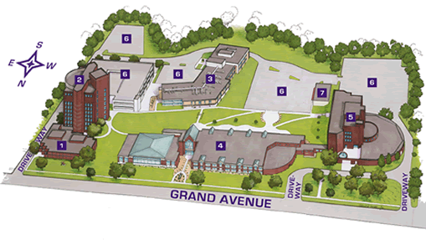
The Smarter Campus
What if you knew which prospective students to recruit?
What if you could detect financial aid fraud?
What if you could identify which students were at -risk of dropping out?
What if you could detect campus crime before it happened?
What if you knew which alumni would donate…and when?
Notes:
Slide a:
SCRIPT: “What if you could accurately predict the future?”
Graphic: Background of Smart district, then circles populating smarter district one by one: who is most at-risk, which teachers need additional support, etc.
Wouldn’t it be great if you could address these issues before they become problems? Imagine a “Smarter” School District. A district in which student outcomes are optimized and ever-improving due to the deployment of a state-of-the-art K-12 student performance solution based on industry best practices which leverages information, business intelligence, and predictive analytics to ensure timely identification of at risk students and enable intervention measures with the goal of improving the student experience, performance and matriculation rate. With the IBM SPSS Decision Management solution, these are just SOME questions that can be answered. The wonderful thing about IBM SPSS Decision Management is that it’s not difficult at all to predict the outcomes.

Slide 27
50%
$4M-$5M
% of students enrolled that receive bachelor’s degree¹
Amount an average sized college loses in revenue to drop outs every year²
66%
60%
% of students retained from freshman to sophomore year³
Of all drop outs, % who drop out during 1st year⁴
$2.9B
55%
US government grants given to students from 2003-2008 who did NOT return for 2nd year⁵
% of freshman that do not graduate from the institution they first enroll in⁶
Colleges are failing in graduation rates,” New York Times, September 8, 2009.
http://www.engagedmindsinc.com/Student-Retention-in-Higher-Education/
2010 Retention/completion summary tables published by ACT Inc. (2010).
http://education-portal.com/articles/Examining_Student_Retention_Study_Links_Drop-Out_Rates_to_High_Numbers_of_Adjunct-Taught_Courses.html
Finishing the First Lap: The Cost of First Year Student Attrition in America’s Four Year Colleges and Universities. American Institutes of Research (2010).
http://www.engagedmindsinc.com/Student-Retention-in-Higher-Education/
Notes:
Higher Education in the U.S. is characterized by a high student failure rate: 25% of Freshmen entering college do not return for their 2nd year
55% of Freshmen do not graduate from the institution they first enroll in
Student drop-outs deprive an institution of important revenue: each student represents between $10,000 and $40,000 in tuition and ancillary revenue and state appropriations.
The annual revenue loss at the post-secondary level is $15Bn. A college of average size loses $4M to $5M in revenue to drop-outs every year, many of which could be prevented.
This loss of revenue is not off-set by significant cost savings: most of the cost of education is shared among students, and the loss of individual students has very little impact on these shared costs. About 75% of the lost revenue "drops to the bottom line" and severely impacts the quality and cost of the education of all students.

Slide 28
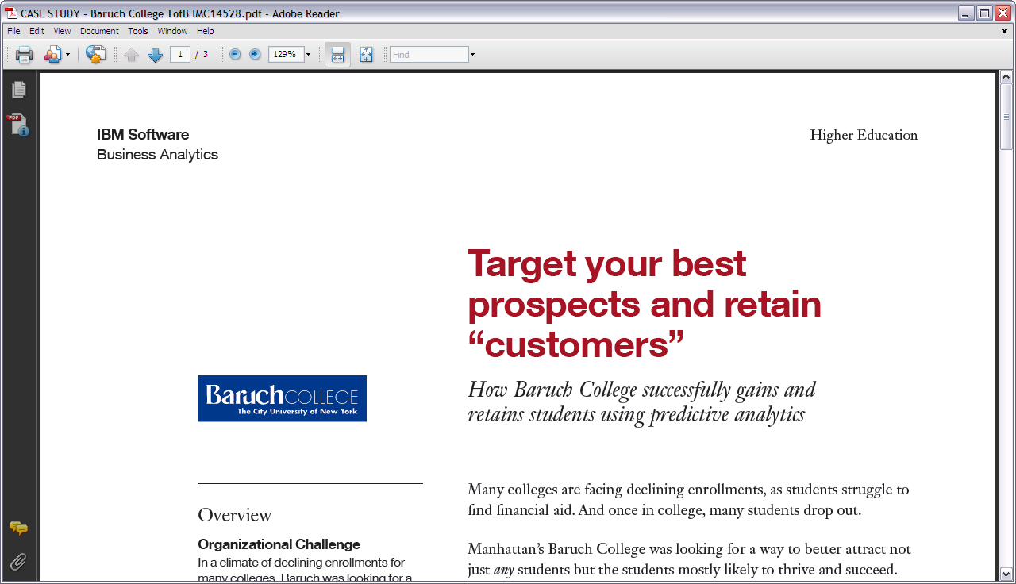
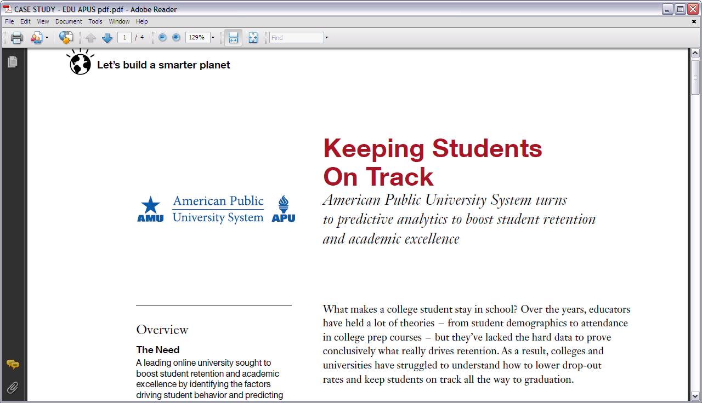

The Smarter Campus
Case Study
Key Stats
Results
Baruch increased application by 7.1% and achieved a 21% annual increase in transfer students.
15,000 FTE
110 Languages
160 countries
The university can predict with ~ 80 % certainty if a student is going to drop out.
70,000 Distance Learners
100 countries
HCDE reduced its annual dropout rate by 25 percent & achieved the best NCLB results in its history
40,000 Students
78 Schools
6700 employees

Slide 29
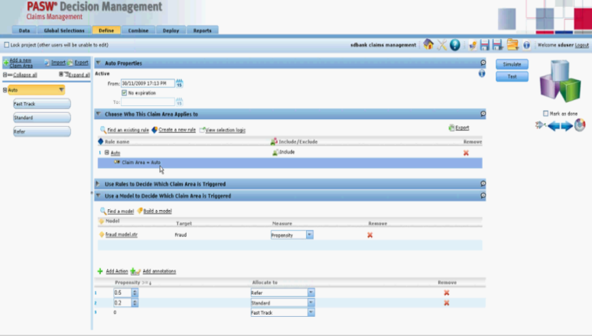
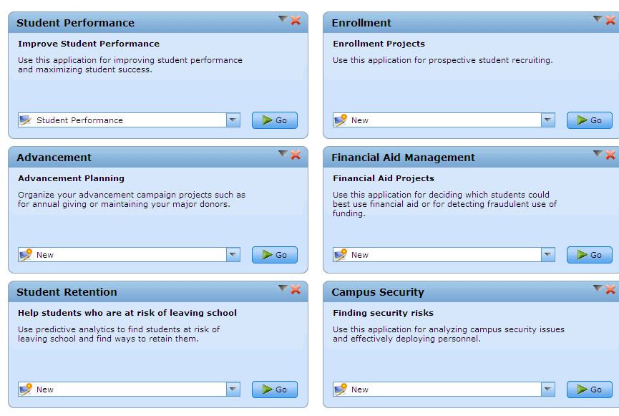
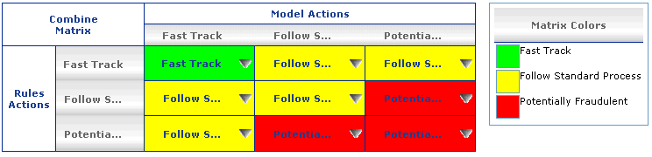

Decision Management for Education (DME)
A software solution that:
Single predictive analytics decision engine
Includes pre-defined, user-friendly, web-based educational applications
Combines institutional rules with predictive analytics for “what-if” optimization
Deploys decisions across all areas
Empowers administrators and educators to be prescriptive
Makes it easy to leverage all available data about students, faculty, campus, community or donors
Bridges the gap between data analysis, predictive insights and improved fact based outcomes
Notes:
Let’s use IBM SPSS Decision Management as a bit of a case to explain how the transformation occurs. Remember that Business Analytics is about answering three questions: What Happened, Why, and What’s Next. When we answer these three things we unlock the power to drive better outcomes.
As an introduction, IBM SPSS Decision Management for Education unlocks the power of advanced analytics to a school district and enables us to create and utilize prebuilt applications for mission-critical issues in K-12 educational systems. It “mashes up” a number underlying technologies – including predictive analytics, business intelligence, and rules for example, and presents them in a way that lets administrators and individual classroom teacher optimize operational decisions with the ultimate end result of improving student outcomes.
Leveraging these powerful technologies is usually very complicated. But we’ve simplified it by identifying the best practices way for K-12 Administrators to optimize their decisions….

Slide 30




Change starts now…
Analytics in the Classroom
Analytics in Research
Analytics in Administration
Analytics for a Smarter Campus
Notes:
At the same time, do you have to have all these pieces to make it work? Absolutely not. However, for the IBM centric customer, IBM’s complete platform can’t be beat.
A successful Customer Intimacy solution doesn’t have to start with the entire IBM portfolio of products. Once the appropriate stakeholders are on board and a strategy is agreed upon, one specific area of the organization, like marketing or customer service, should be focused on for the next 3 months. Have a realistic goal or benchmark to improve click through or open rates for email messages or strive to cut down on customer service call time by 15% by enabling your reps with the appropriate and customized information for each call scenario.
The right technology for the right problem
All software products should be integrated with one another as well as integratable with legacy hardware and software already existing in the infrastructure
You need to be able to support the full lifecycle needs of how your company interacts with a customer, from initial conversations to analyzing data to deploying solutions to various parts of the organization
Technology should be accessible to everyone in the organization
Measure, document and share your successes. This shouldn’t be considered bragging. Instead, it should be a way to show other departments how this strategy could affect them and also give your CEO a reason to continue to fund the project and roll it out to more and more departments.
This solution shouldn’t be just rolled out and forgotten about. While you may be going to market with the best approach in your mind, there are always new scenarios and lessons that are learned, and should be applied back to your models, decisions, and business rules.
Regardless of your stage of maturity, IBM can help you formulate and implement breakaway strategies for your decision making challenges.

Slide 31

IBM100 Logo

